Slide 1
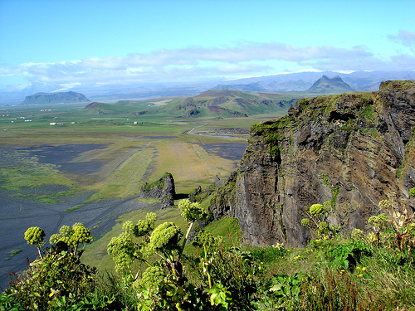
Landforms and Water bodies

Slide 2
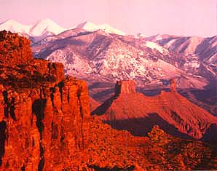
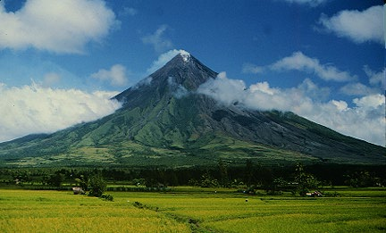
Landform
Landforms are the natural shapes or features of land.

Slide 3
Types of Landforms
1. Mountain
2. Hills
3. Valley
4. Plain
5. Plateau
6. Peninsula
7. Isthmus
8. Island

Slide 4
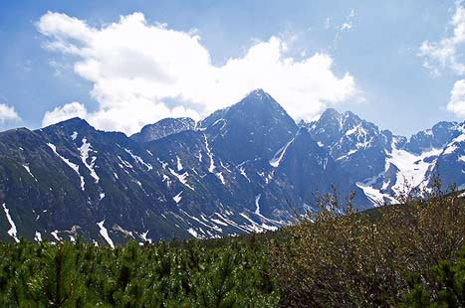
Mountain
A mountain is a place on Earth’s surface that is much higher than the land around it.

Slide 5
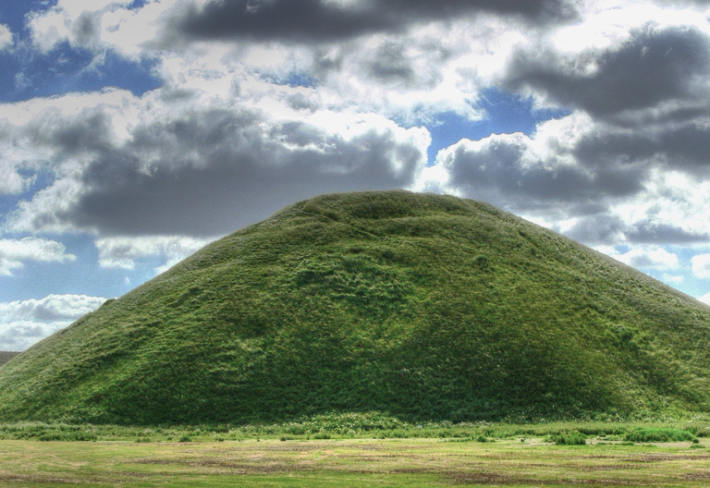
Hill
A hill is a raised area or mound of land

Slide 6
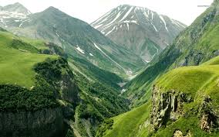
Valley
A valley is a lowland area between higher lands such as mountains. Some valleys have a river or stream flowing through them!

Slide 7
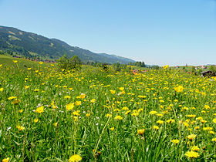
Plain
A plain is a flat area with few trees.

Slide 8
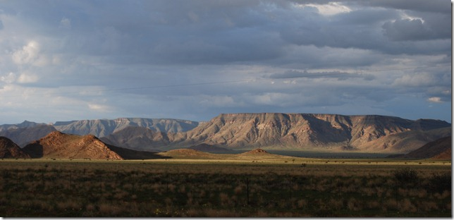
Plateau
A plateau is a flat area higher than the land around it. This looks like a mountain with no peak!

Slide 9
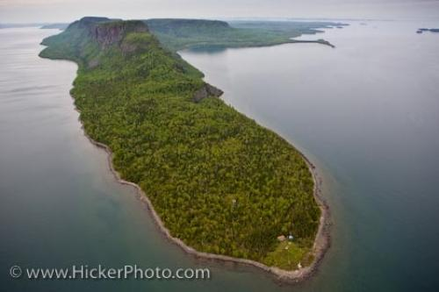
Peninsula
A peninsula is a body of land that is connected to a mainland and surrounded by water on three sides.

Slide 10
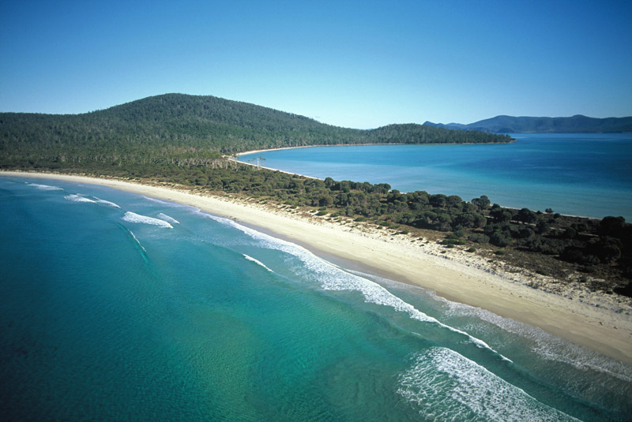
Isthmus
An isthmus is a narrow strip of land that connects two larger areas of land, usually with water on both sides!

Slide 11
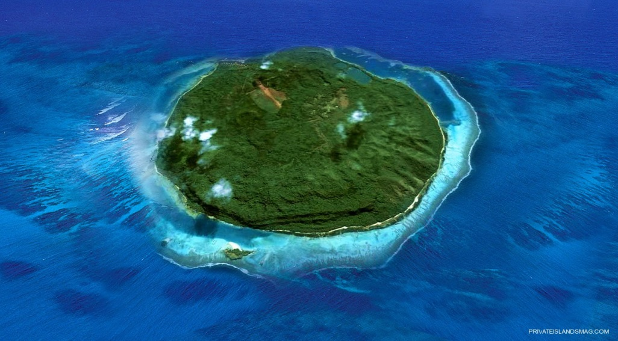
Island
An island is land that is completely surrounded by water.

Slide 12
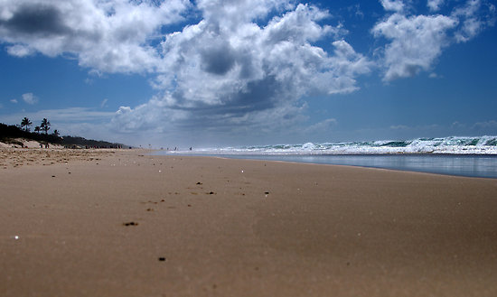
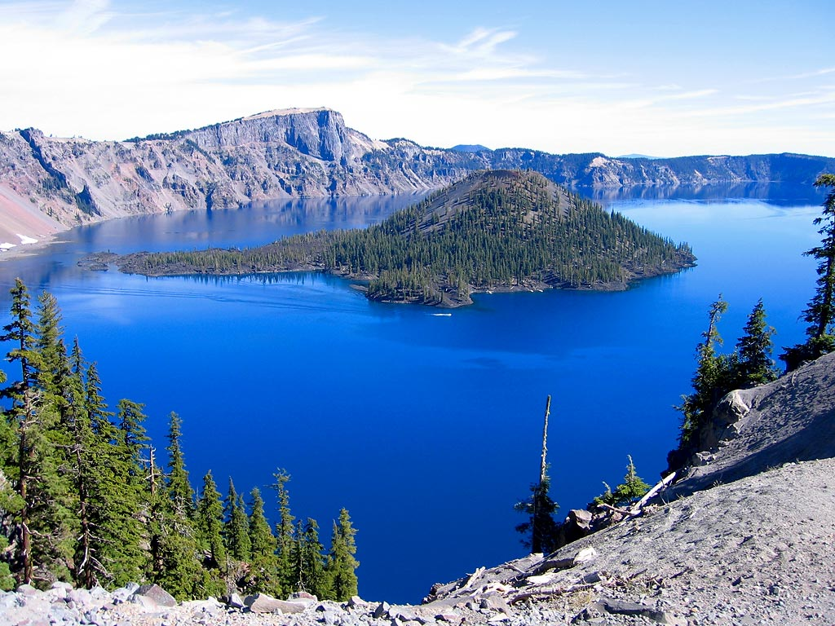
Water bodies
Water body is accumulation of water on Earth’s surface

Slide 13
Water forms
1. Ocean
2. Sea
3. Rivers
4. Lakes
5. Bay
6. Strait
7. Pond
8. Wetland

Slide 14
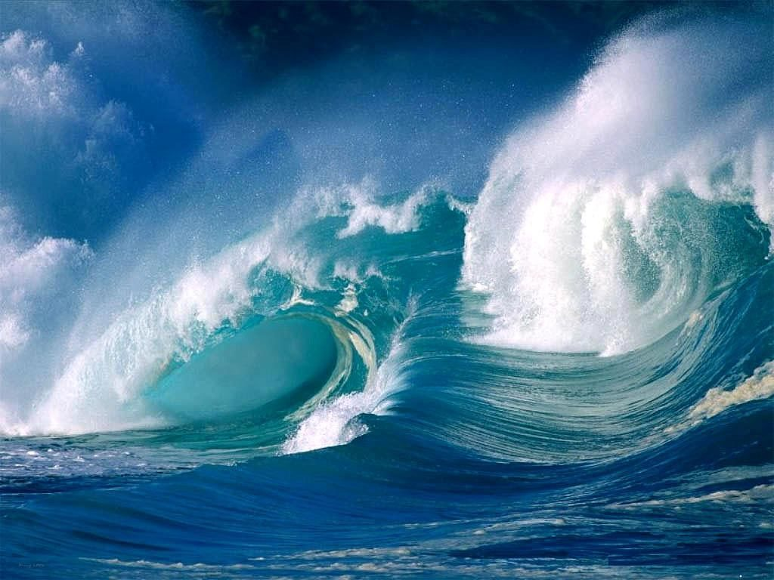
Ocean
Made up of salt water and are the largest bodies of water on earth.

Slide 15
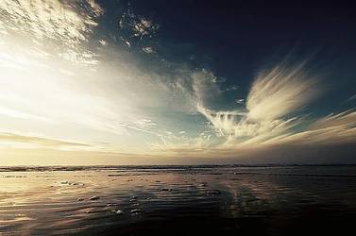
Sea
Smaller than oceans, made up of salt water but for the most part are landlocked.

Slide 16
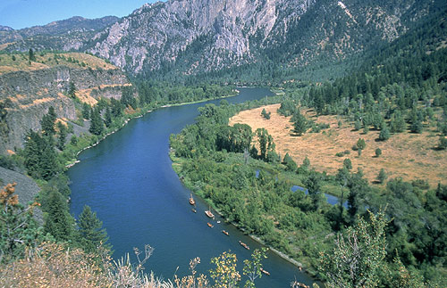
Rivers
Bodies of fresh, moving water. Every river begins at the “source” and ends at the “mouth”.

Slide 17
Lakes
A large natural area of water completely surrounded by land.

Slide 18
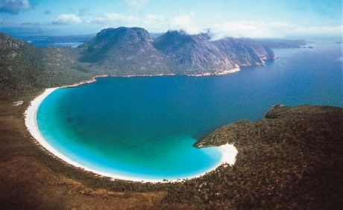
Bay
A bay is formed when the coast of an ocean curves into the land. The water in a bay is often calm since the surrounding land blocks wind from forming large waves.

Slide 19
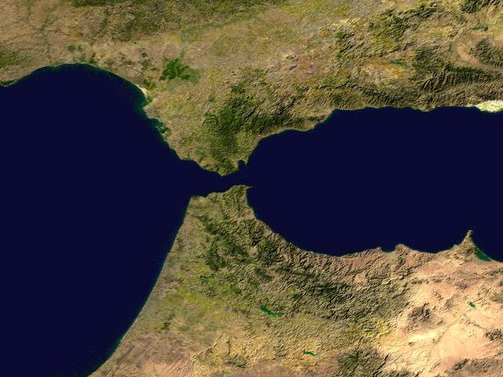
strait
A strait is a naturally occurring passage way between two bodies of water that is wide and deep enough for a water vessel to travel through.

Slide 20
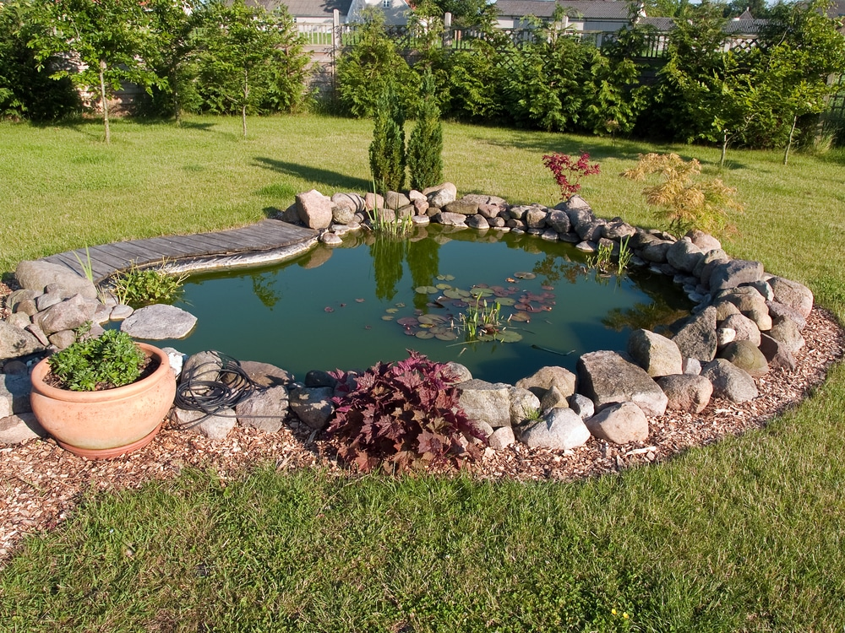
Pond
A very small body of water that is surrounded by land.

Slide 21
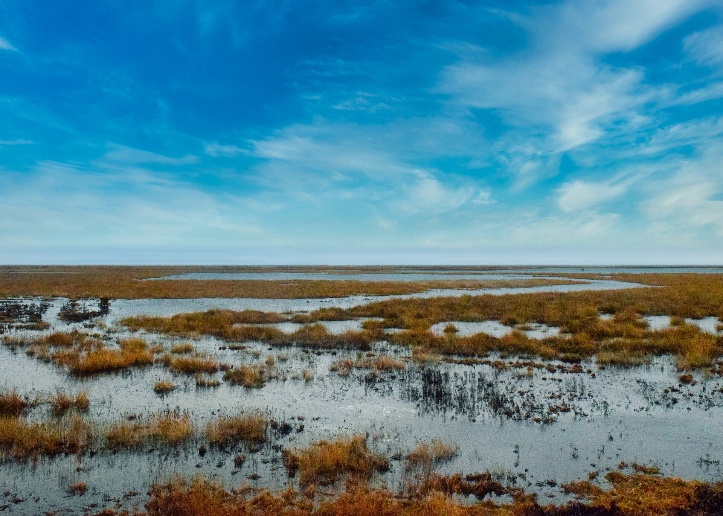
Wetland
An area of wet, soggy land with many pools of water

Slide 22
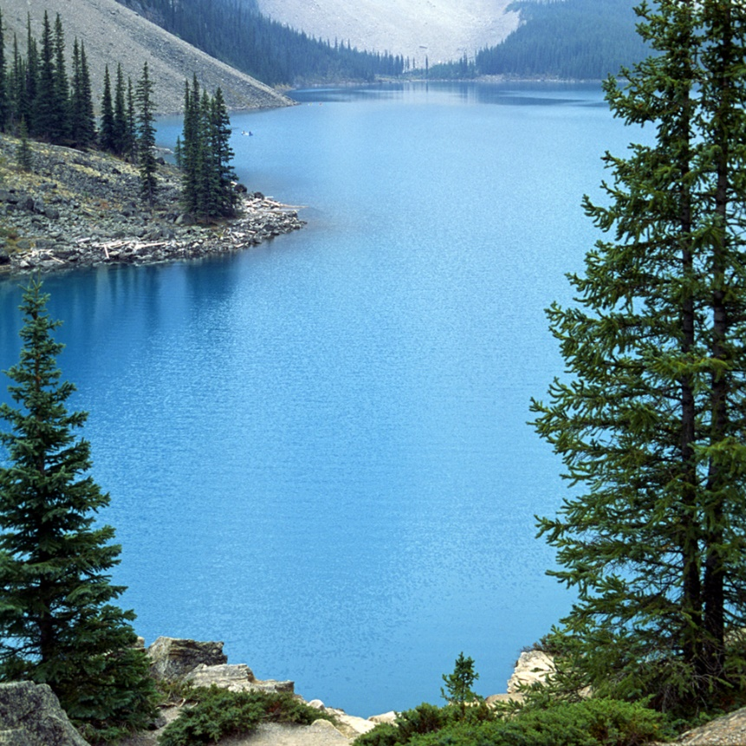
A _________ is water with land all around it.
Ocean
Island
Lake
Hint

Slide 23
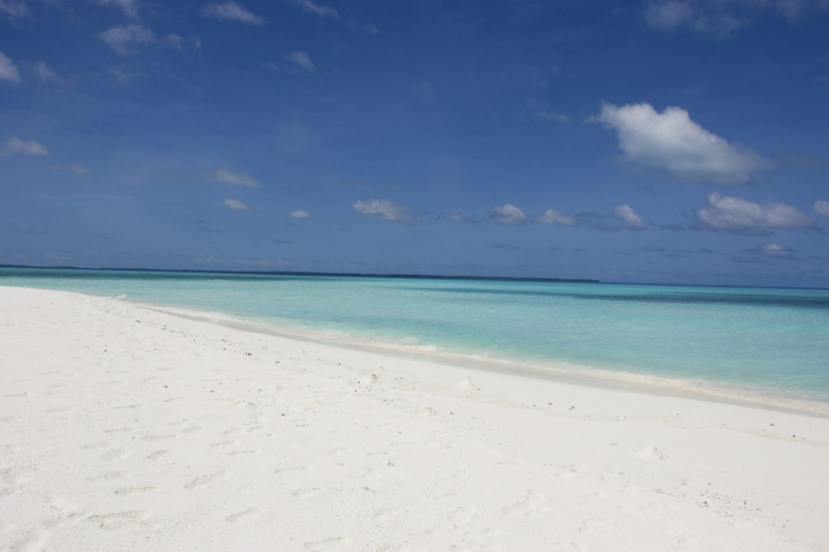
What is the largest body of water on Earth?
Ocean
Lake
River
Hint

Slide 24
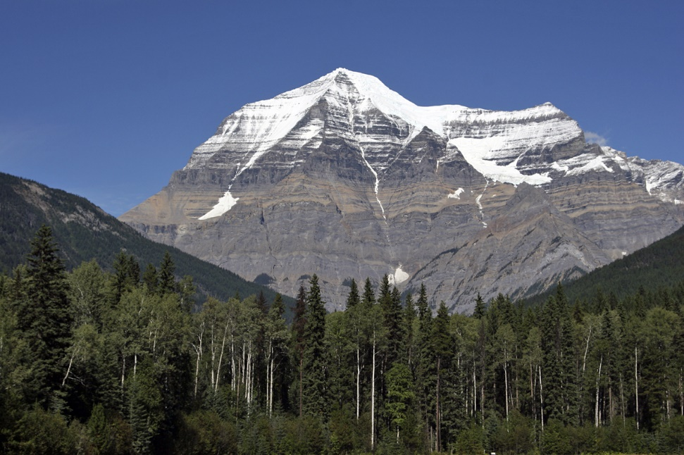
A _______ is higher than the land around it.
Island
Mountain
Valley
Hint

Slide 25
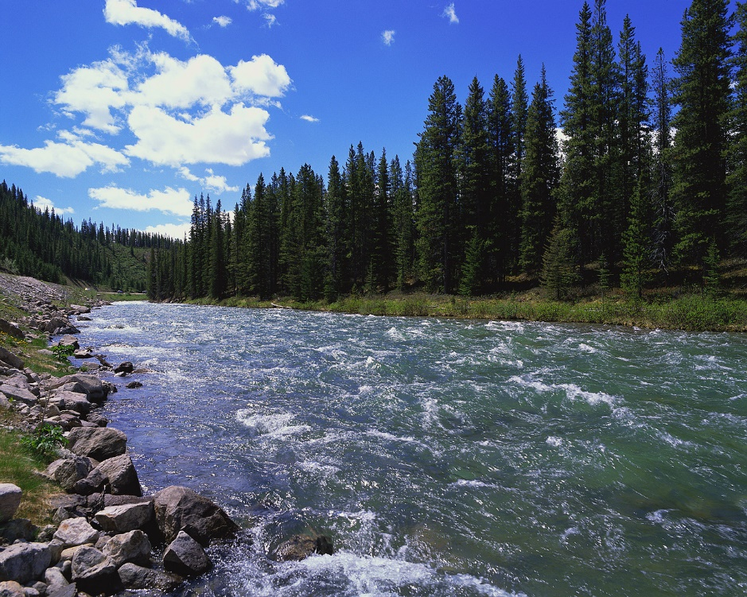
What is a flowing body of water?
Plateau
Lake
River
Hint

Slide 26
I am land and have water all around me. What am I?
Island
Coast
Desert
Hint

Slide 27
Homework EVS 2B workbook Page – 37 and 39 Color the water bodies cut and paste it next to the description.

